Slide 1
Contract Implementation
2023

Slide 2
Afshin Arian DMD NV Medicaid Dental Director P: 888.401.1128 x6240 C: 702.600.1613 aarian@libertydentalplan.com
Meet Our Nevada Chief Dental Director

Slide 3
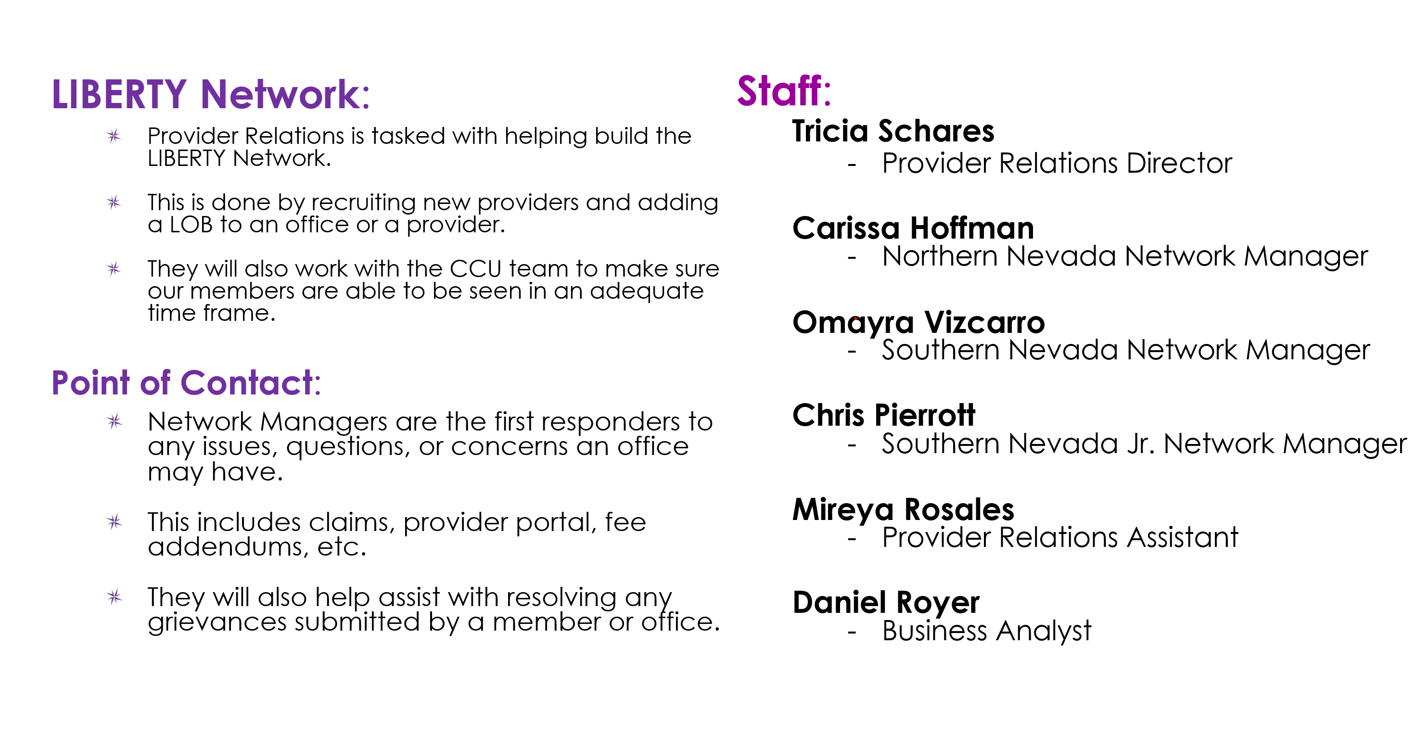
Provider Relations

Slide 4
2023 Value Added Benefits
Code | Description | Rate | Effective Date | Pregnancy | Service for Persons Age 21 Years and Older | Service Limits | Documentation Requirements
D0150 | Comprehensive Oral Exam | 33.24 | 1/1/2023 |  | x | One per member every 12 months | N/A
D1110 | Prophylaxes | $45.00 | 1/1/2023 | X |  | Two additional every 12 months | Narrative
D1354 | Silver Diamine Fluoride | $12.30 | 1/1/2023 |  | X | Two per year | X-rays, narrative
D3310 | Root Canal | $205.00 | 1/1/2023 | X |  | One per member per calendar year | Pre & post-operative periapical x-rays
D3320 | Root Canal | $246.00 | 1/1/2023 | X |  | One per member per calendar year | Pre & post-operative periapical x-rays
D3330 | Root Canal | $327.99 | 1/1/2023 | X |  | One per member per calendar year | Pre & post-operative periapical x-rays
D4346 | Gingival Scaling | $53.00 | 1/1/2023 | X |  | One additional Gingival scaling per year | X-rays, narrative, perio chart
D9995/9996 | Teledentistry | $10.00 | 1/1/2023 | X |  | No limitations | N/A
www.libertydentalplan.com
4

Slide 5
Benefit Changes or Explanations
SEALANT REPAIR - LIBERTY has updated the frequency for repairs to be approved after 2 years from sealant placement.
Neon Program
LIBERTY would like to remind you that an adult Medicaid member may qualify for a partial when missing any one of six upper/lower anterior teeth (6, 7, 8, 9, 10, 11, 22, 23, 24, 25, 26 or 27) when necessary for employment.
A supportive written letter from Division of Welfare and Supportive Services (DWSS)
New Employees of Nevada (NEON)
The NEON report must be maintained in the recipient’s dental record for respective review.
Pregnant Members
The current additional value-added services for pregnant adults are:
Two additional cleanings (prophylaxis) every 12 rolling months
1 deep cleaning every 12 months (D4346)
Root canal every 12 months
Eligible for case management services.
Eligible for $25 gift card for utilization of services (Healthy Behaviors).
*Subject to change.

Slide 6
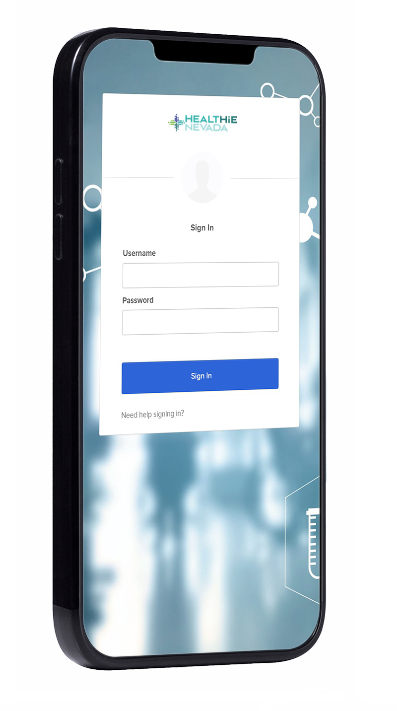
HealtHIE Nevada
ELECTRONIC HEALTH RECORDS ADOPTION AND NEVADA HEALTH INFORMATION
LIBERTY participates in the Nevada statewide health information exchange (HIE) known as HealtHIE Nevada as required by our contract with DHCFP.
LIBERTY’s contracted Providers are encouraged to contribute to member’s clinical data to the HIE or to access data from the HealtHIE Nevada portal (i.e., electronic health records of your patients).
Receive additional information from your designated Network Manager, or by contacting HealtHIE Nevada at HIEsupport@healthienevada.org, or 855-4-THE-HIE.
Please note that Medicaid and Nevada Check Up members may not opt out of having their individually identifiable health information disclosed electronically, per State law.

Slide 7
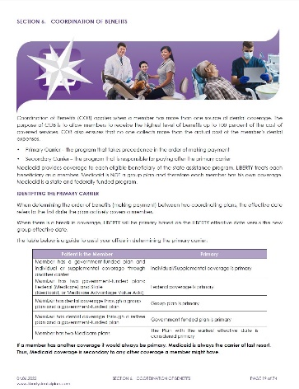
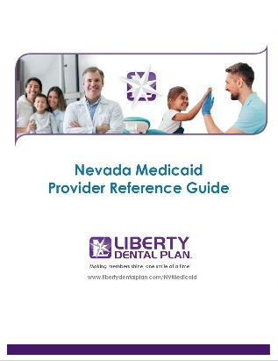
Provider Resources
Provider Portal
Provider Reference Guide
Provider Online Enrollment
Provider Relations Team

Slide 8
Provider Reference Guide (PRG)
All the content we are reviewing today can be found in our PRG.
Some of the highlights include:
LIBERTY’s case management program to provide extra support for members with complex dental and medical needs.
Opportunity to participate in value-based programs and performance bonuses.
Priority populations served in the contract including pregnant women.
New benefits available
Check out our PRG online: (https://client.libertydentalplan.com/NVMedicaid) Visit often - the online version is always up to date!

Slide 9
2023 Provider Training
On-Demand Training - Available on Portal
Grievance and appeals
Claims
Dental Records
Abuse and Neglect reporting - vulnerable adults
Monthly Training Offered by Provider Relations Team
Monthly provider portal training
Claims and pre-auth Submission
Corrected Claims process
Eligibility and Benefits
New Office Orientation - as needed
Quarterly Webinars Planned for 2023
SDOH – Q1
Culturally Competent Dentistry – Q2
Specialized IDD training – Q3
Screening, Brief Intervention and referral to Treatment – Q4
Annual Compliance Training
https://www.libertydentalplan.com/Providers/Provider-Training-1.aspx?_ga=2.108010818.1936080356.1667584776-323852073.1667584776
Make sure to take advantage of these training opportunities and ask your network manager if you have any questions.

Slide 10
Obligations and Rewards of Serving as a Dental Home
Meet your members at least twice a year. (Use outreach methods to reach them if necessary.)
Comply with state's accessibility standards to provide 24-hour support
Coordinate referrals to specialty care and educate and engage your members.
In return, we offer:
Data on your panel (through our portal),
Incentives for bonus programs,
The ability to earn rewards through our BRUSH value-based program.

Slide 11
LIBERTY’s Requirements for a Complete Dental Record
Name, DOB, and ID number
X-rays clearly labeled with patient name and Date of Service (DOS)
Clinical notes along with signature from rendering clinician
Records include treatment performed and billed
Personal/demographic data
Records should be legible and easy to read for the reviewer
It is important that all documents submitted to LIBERTY as part of a records request contain the appropriate identifying patient information.

Slide 12
Value-Based Programs
LIBERTY’s BRUSH program is the first of its kind nationally and seeks to engage providers in our mission to improve oral health outcomes.
The goals of BRUSH are to:
Focus care on the prevention of dental disease
Engage members in managing their oral health
Improve members' overall long-term oral health and wellness
Reward providers for healthy member outcomes
If you serve Medicaid children in Nevada, your practice is eligible to receive payment for Caries Risk Assessments administered, enhanced member benefits, and annual bonuses based on healthy member outcomes.
Contact your Network Manager to learn more or to sign up for BRUSH today!
Benefits
Rewards
Utilization
Services
Healthy Outcomes

Slide 13
Grievance and Appeals
Provider Reminders for Member Appeals
Providers must submit written consent from their members anytime they are filing an appeal on their behalf- this includes Emergency appeals
Be aware that all appeals have a strict timeframe. Providers are to submit documentation on medical necessity including proof and reasons with the initial appeal submission
A member request for a State Fair Hearing must be made within 90 days from the date on Liberty’s notice of resolution.

Slide 14
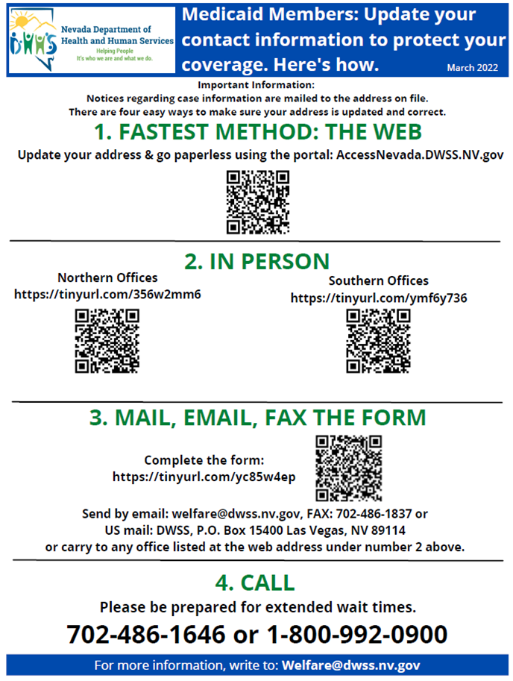
Unwinding the Public Health Emergency
Please help us to educate members about the importance of keeping their contact information current.

Slide 15
Case Management Program
Case Management helps members access dental care in the right setting based on their specific needs, utilizing the right Providers, in the right time frame, and in a cost-effective manner.
Case management supports members with complex oral and physical health needs, including children with special health care needs and pregnant women, among others.
LIBERTY uses nurse Case Managers and Care Coordinators to engage and support members by assessing their needs, developing an individual nursing plan of care, coordinating with other providers and medical insurance, helping to arrange transportation or other supports, and following-up to ensure care was received.
If you think one of your patients would benefit from this support, you can refer members to our case management team in several ways:
Upload a NV LIBERTY Dental Plan Case Management Referral Request Form through the Provider Portal, email the form to casemanagernv@libertydentalplan.com, fax the form to 949-825-8200, or contact your designated Network Manager.
Refer the member to LIBERTY’s Member Services Department.

Slide 16
Community Smiles Program
LIBERTY will be offering training for providers on how to support member social determinant needs in Q1 2023. In addition, please feel free to share the following website with any LIBERTY member in need: communityresources.libertydentalplan.com.
Social Determinants of Oral Health are “the conditions in which people are born, grow, live, work, and age… shaped by the distribution of wealth, power, and resources at global, national, and local levels.”
- World Health Organization
The social determinants of health can have a greater impact on health outcomes than health care.
They can also result in barriers to utilizing dental benefits or adhering to treatment plans.
Social Determinants of Oral Health
LIBERTY’s Community Smiles Program is the first of its kind for a dental benefits plan.
Our program connects our members to free and low-cost community resources to address needs such as food insecurity, housing, lack of transportation. Members can also self-search for programs on our website using the findhelp.org platform.
Environment
Mental Health
Income
Social Isolation
Housing
Transportation
Access to Health Care
Poor Dental Health
Food Insecurity

Slide 17
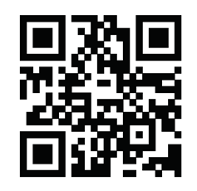
Healthy Behaviors Program
Child members and pregnant members who haven't had a in-person or virtual visit in 12 months can qualify for a $25 gift card through our Healthy Behaviors Program! To receive the card, they must visit our Healthy Behaviors Program website to sign up.
Encourage your LIBERTY patients to visit this website to sign-up.

Slide 18
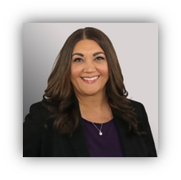
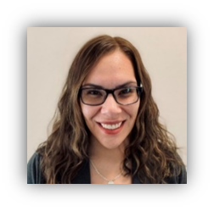
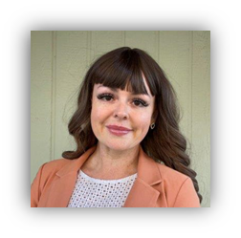
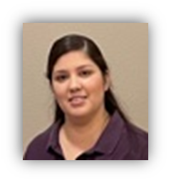
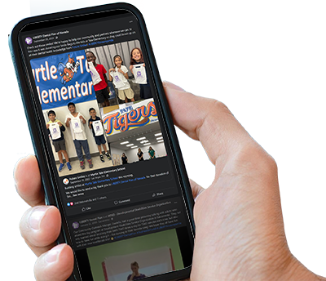
Community Outreach
Our community outreach includes in-person and virtual presentations, trainings, distribution of educational materials, supporting community events, coordinating access to preventive services with local providers, and participating in sponsorship opportunities including dental supply donations.
Join Us in Serving Members in the Community!
Provide oral health screenings and services
Offer oral hygiene education
Discuss dental field as a career
Laurie Curfman
Director Community Outreach and Account Management
Tamara Stubblefield
Community Outreach Manager
Nevada
Hazel Moreno
Health Outreach & Literacy Coordinator
Washoe County
Contact Our Provider Relations Team to join us at an event!
Like us on Facebook and follow us on Instagram for announcements and more!
Tag us #LIBERTYLovesMySmile or @libertydentalplannv
Kristina Ramos
Health Outreach & Literacy Coordinator
Clark County
Yasemin Mendoza
Health Outreach & Literacy Coordinator
Clark County

Slide 19
The End!
www.libertydentalplan.com

